Slide 1
Business Analytics of Convenient Food Mart
Code Pandas
Dave Anshul
Dhole Deepak
Nadipelli Amuktha Malyada
Shenoy Aditya
Simeen Afia
Zhang Zizheng

Slide 2

Introduction
Data merged with business objectives can unravel new opportunities and possibilities in various realms
Proposing to analyze the data from a chain of convenience stores, we intend to infer the store profitability relative to demographic elements, customer preferences, and marketing strategies
Aiming to drive the commercial success of each store, we aim to formulate profitable business strategies for each store

Slide 3

About our DataFrame
Our dataset contains data about Convenient Food Mart, a big chain of grocery stores.
It consists of over 60,000 records and 40 features of customers' details, their shopping preferences and store details of Convenient Food Mart (CFM).
The data was obtained from Kaggle, where the Kaggle user had originally scrapped it, using BeautifulSoup, from an unmentioned website.

Slide 4
MISSION
Transforming the information into quality data
Deriving actionable intelligence to enable informed strategies and optimize business operations

Slide 5
01.
Data Processing

Slide 6
Data Processing Tasks
Data cleaning tasks included:
Checking for and dropping null values
Selecting the data belonging to the United States
Dropping irrelevant columns
Re-indexing the data
Data source: https://www.kaggle.com/datasets/ramjasmaurya/medias-cost-prediction-in-foodmart?resource=download

Slide 7
02.
Data Features Analysis

Slide 8
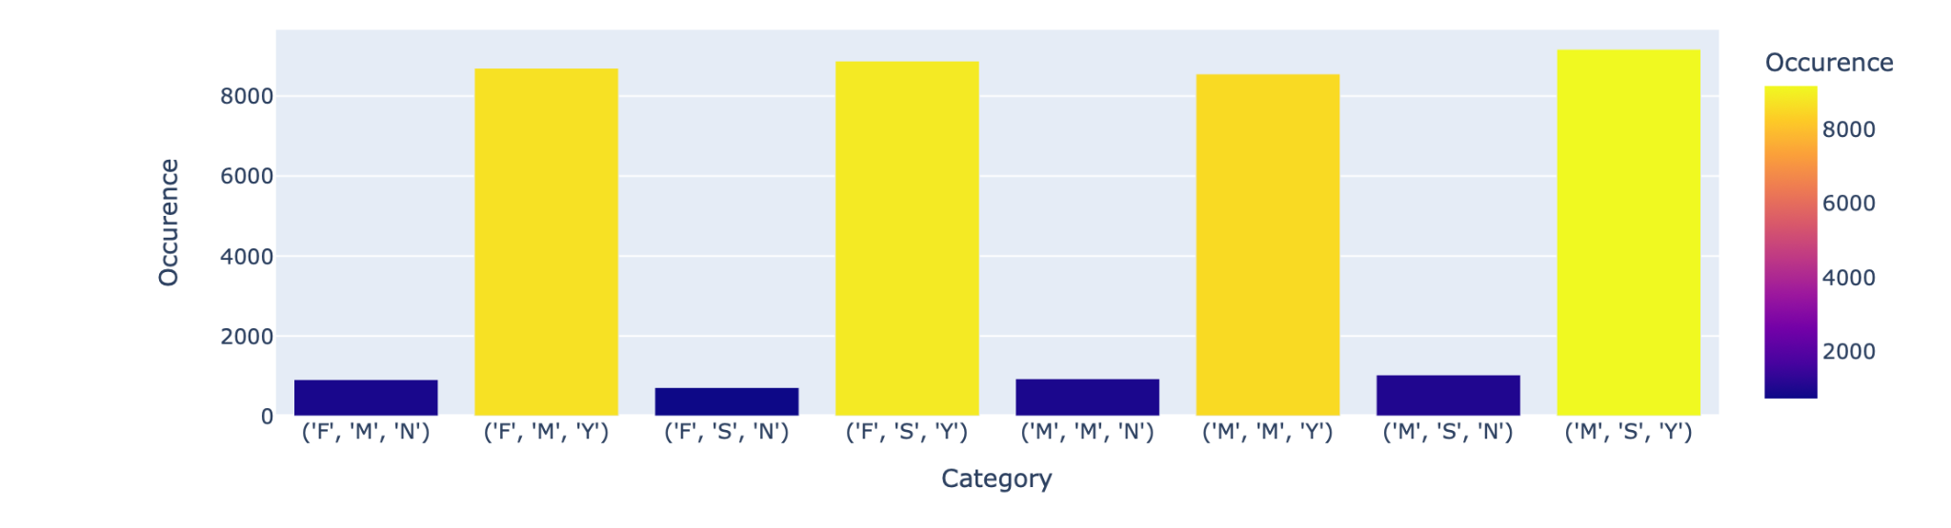
Demographic Data Analysis
F- Female | M- Married | Y- Have children
M- Male | S- Single | N- No children

Slide 9

Demographic Data Analysis
Observations:
Customers are fairly similar for gender and marital status.
Most customers are Child-Bearers.
“We’re relying on the kid to pester the mom to buy the product, rather than going straight
to the mom.”
More Disposable income.
Influence over business strategy:
Advertising
Creating a Child-Inclusive environment.
In-store modifications.

Slide 10
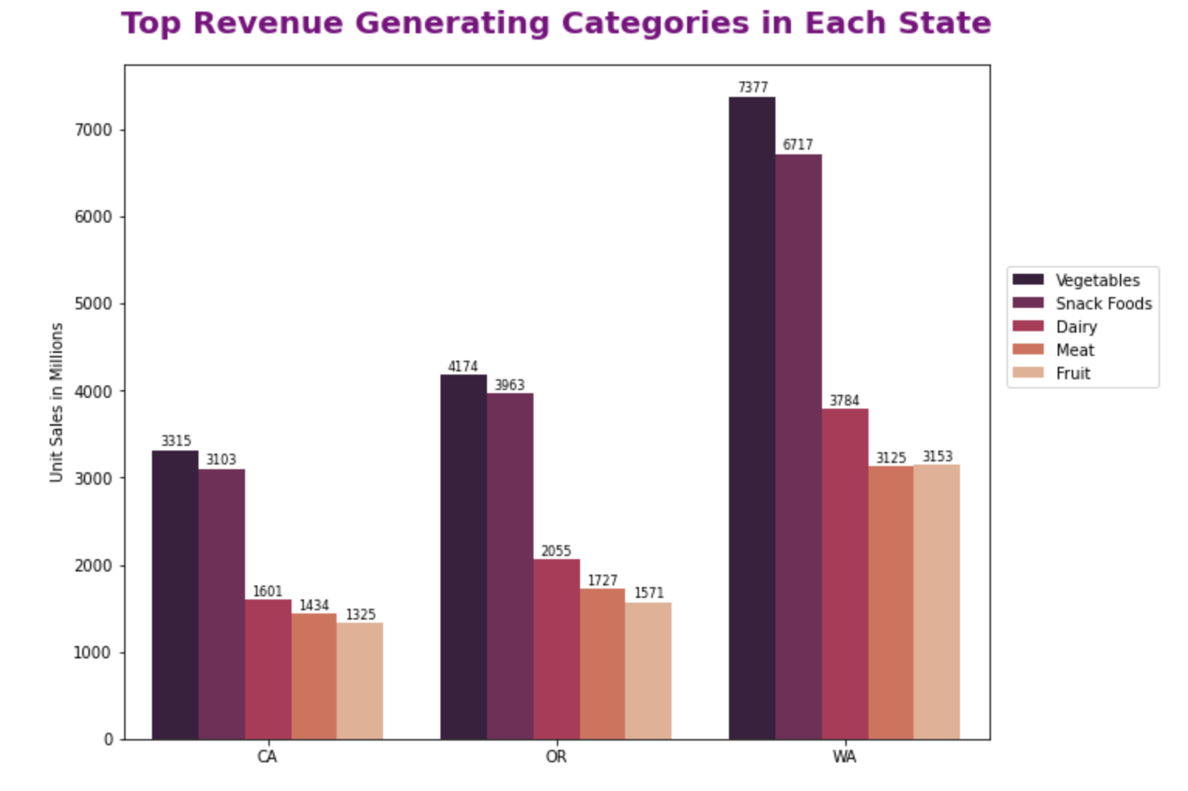
Product and Geographical Data Analysis

Slide 11

Product and Geographical Data Analysis
Observations:
All states across the US follow a similar and dominant trend
Commodities contribute a significant proportion of sales at the stores
Snack Foods are next to commodities in driving substantial revenue at the stores
Business strategies should be focused on these categories to support and boost the sales in each store
Influence over business strategies:
Expanding aisles for top selling categories at the stores to further increase sales
Partnering with more suppliers to support timely replenishment of products and optimize the expansion project

Slide 12
03.
Predictive Analysis of Customer Income

Slide 13
Motivation
Predicting yearly income of consumers to differentiate consumer segments and developing customized promotion strategies to improve customer retention for the store chain.

Slide 14
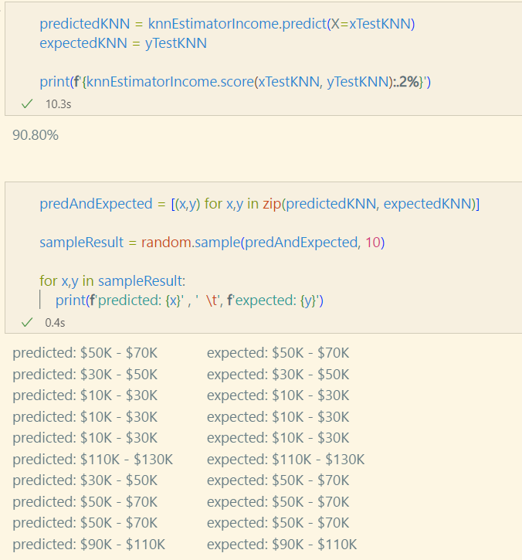
Model Outcome
Model Used : KNN - Classification
The prediction for the model: 90.8%.
Model Inference
New membership cards can be issued to the customers based on the income level and occupation to increase the customer retention
Special features such as delivering goods for free can be introduced to core customers making grocery shopping a more personalized experience

Slide 15
04.
Predictive Analysis of Customer Acquisition Cost

Slide 16
Motivation
Optimizing customer acquisition strategies for different customer segments by predicting costs based on customer features.

Slide 17
Model Outcome
Model Used : OLS, Decision Tree, XGBoost
Best Performing Model: Decision Tree (RMSE = 26.59)
Model Inference
Management needs to focus on collecting data on customer behaviour within stores
Features such as time spent in the store, response to promotional deals, share of wallet, etc need to be collected via surveys and other research methods

Slide 18
Thanks!

